Slide 1
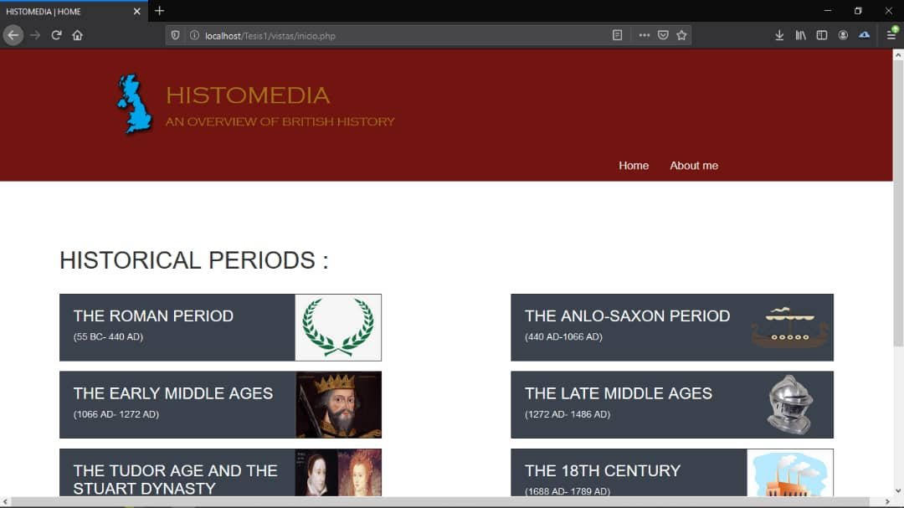
III INTERNATIONAL SCIENTIFIC CONVENTION 2021
SIMPOSIO INTERNACIONAL “DESARROLLO HUMANO, EQUIDAD Y JUSTICIA SOCIAL”
2021
HISTOMEDIA: A MULTIMEDIA PROPOSAL FOR UNDERSTANDING HISTORY OF ENGLISH-SPEAKING COUNTRIES I IN PURSUIT OF INTERCULTURALITY
UCLV
Authors: Arianna Hernández Arregoitia. BA (harregoitia@uclv.cu)
Juana Idania Pérez Morales. PhD- (juanap@uclv.edu.cu)
1. INTRODUCTION (OBJECTIVES)
3. RESULTS AND DISCUSSION
English has become increasingly dominant as a world language for communication in higher education. According to Warschauer, M., the simultaneous impact of globalization, the spread of English and technological development have transformed our learning and teaching of English as a lingua franca in an unprecedented way (Warschauer, 2004). However, a good command of English also entails the understanding of history as a parameter of the culture of English speaking countries, in order to acquire a more complete overview of the Anglophone world. Furthermore, the incorporation of information and communication technologies (ICTs) to the classroom has fostered the acquisition of knowledge for our students are provided with multimedia resources that work together with traditional face to face instruction.
In Cuba, universities actively interact with ICTs at a social and institutional level. However, in the context of the teaching and learning process of the subject History of English-Speaking Countries I, devoted to the study of British History, taught in the degree course English Language with French as a Second Foreign Language in the Universidad Central “Marta Abreu” de Las Villas, some difficulties concerning the bibliography have been evidenced.
In the light of this problem, the present paper focuses on a study to propose a multimedia (HistoMedia) to support the teaching and learning process of the aforementioned subject. The following specific objectives guided the study:
To diagnose the needs concerning the bibliography of the aforementioned as well as the availability of ICTs resources.
To design HistoMedia multimedia including a more varied bibliography to support the teaching and learning process of the subject History of English- Speaking Countries I .
To assess the multimedia proposal according to the criteria of specialists from the area of the United Kingdom History.
A survey was applied to 17 students in order to determine the situation regarding the bibliography of the subject History of English-Speaking Countries I. The results obtained from the survey were:
-76 % of the total recognized that there is complementary bibliography in the subject´s folder. - -24% of the students seemed to believe that the subject’s folder included its basic bibliography. -82% of the respondents considered that the bibliography is not enough.
-only 18% affirmed that the bibliography was sufficient for the development of the teaching learning process.
When asked about the possible solutions to this problem, most of the students
-52% agreed to include more instructional materials from different sources.
-29% granted to incorporate interactive activities for self-assessment and conscious learning for each content studied in the subject History of English-Speaking Countries I.
A well- structured interview was applied to the department authorities who stated the following: “It is essential to include recent studies, documentaries, and scholar findings.”
“A chronological arrangement through documentaries and maps could be a suitable way to systematize students’ general comprehension of the subject.”
While designing the HistoMedia multimedia its content structure was presented in a simple and accessible way, which allowed the user to find the materials effortlessly. The material was organized by the content of each unit of the subject syllabus, and information was taken from reliable sources.
Finally, the proposal was presented to specialists from the area the United Kingdom History, who agreed that HistoMedia multimedia met the necessary requirements, from which it was deemed a valid proposal for the improvement of the teaching and learning process of the subject.
2. METHODOLOGY
4. CONCLUSIONS
The research process mainly adopted a qualitative research perspective. This method was deemed the most appropriate in social sciences supported by the dialectical-materialistic method from which some theoretical, empirical and statistical and/or mathematical methods are derived.
- Document analysis: was used to analyze the main documents in respect to educational policies concerning the research context with the purpose of finding out what is regulated in relation to the teaching and learning process of the subject History of English- Speaking Countries I in the degree course English Language with French as Second Foreign Language
-Surveys: was applied to a sample of 17 students from the fourth year and the professor of the subject in order to get a deep understanding of the bibliography needs in the subject and how it may affect their academic achievement in History of English- Speaking Countries I. Furthermore, the students’ and professor’s opinions, ideas and motivations towards the subject were relevant in this research.
-Sample selection: In selecting the participants, an intentionally selected sampling procedure was employed. In this case, fourth year students of English Language with a second foreign language: French as well as the principal professor. This group was selected because they are the ones taking the subject History of English- Speaking Countries I.
1. Multimedia is a digital, organized and comprehensive collection of information represented in human-computer interactions that facilitate the teaching and learning process. They have been used in higher education as an ICTs tool due to its flexible nature, which allows the designer to adjust the media and use it for a wide variety of audiences.
2. Both students and professors agreed that the bibliography of the subject History of English-Speaking Countries I should be improved and complemented with new resources in order to enhance students’ comprehension of the Anglophone world. Hence, the information and materials included in the HistoMedia multimedia were taken from reliable sources, taking into account the subjects’ syllabus.
3. Although the HistoMedia multimedia is about to be implemented in the course English Language with French as Second Foreign Language, the specialists from the area of United Kingdom History considered the proposal as a valid contribution for the improvement of the teaching and learning process of the subject.
5. REFERENCES
HOME PAGE OF THE HISTOMEDIA MULTIMEDIA
Bartlett, R. a. (2003). Multimedia versus traditional course instruction in introductory social psychology. Teaching of Psychology.
Biggs, P. (2003). Information and Communication. United Nations Conference on Trade and Development (p. 4). New York and Geneva: United Nations Publication.
Brink, B. B. (2013, November 14). Multimedia in Education Curriculum. Retrieved April 25, 2017, from UNESCO Institute for Information Technologies in Education: http://www.iite.unesco.org/pics/publications/en/files/3214723.pdf
Byram, M. (1997). Teaching and assessing intercultural communicative competence. Clevedon, UK: Multilingual Matters.
F. Nemetz, J. (1998). Developing Multimedia Principles from Design Features. New York.
Gokhe, M. (2012). Information and Communication Tecnology. Houston.
Ibáñez, J. I. (2012). Language and Culture of the English- Speaking Countries through ICT in and out of
Kramsch, C. (2000). Language and Culture. Oxford: Oxford University Press.
Mactavish, G. a. (2004). Multimedia. In G. a. Rockwell, Multimedia for the Companion to Humanities Computing. London: Blackwell Press.
Milea, O. M.-S. (2013). Telecommunications Services in the Knowledge Economy. (Vol. XIX). Tibiscus: Timisoara.
Robins. (1999). Times of Technoculture. New York.
United Nations Educational, Scientific and Cultural Organization (UNESCO). (2007). The UNESCO ICT in Education Programme. Bangkok: UNESCO.
Warschauer. (2004). Technological change and the future of CALL, New perspectives on CALL for second and foreign language classrooms. Mahwah: In S. Fotos & C. Brown (Eds.).

