Slide 1
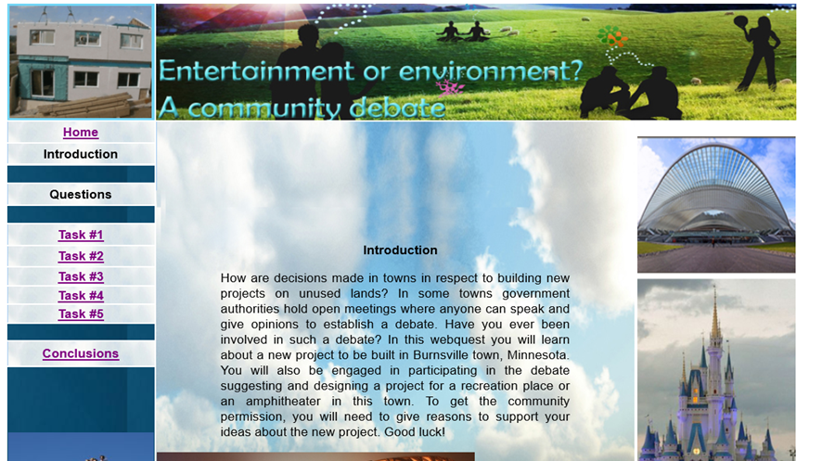
INTERNATIONAL SYMPOSIUM "HUMAN DEVELOPMENT, EQUITY AND SOCIAL JUSTICE"
2021
USING WEBQUESTS FOR ORAL COMMUNICATION IN ENGLISH FOR SPECIFIC PURPOSES FOR ARCHITECTURE STUDIES
UCLV
MSc. Yanet Sánchez Carrera, Dra. Juana Idania Pérez Morales
1. INTRODUCTION (OBJECTIVES)
3. RESULTS AND DISCUSSION
The educational policy of the Cuban Higher Educational System demands professionals training in a foreign language and the domain of English to suit professional and work needs. It is a key competence necessary to face the challenges of modern society. Architecture students at Universidad Central “Marta Abreu” de Las Villas (UCLV), should be able to communicate in English effectively and to develop the four major language skills to become competent professionals in their area of knowledge.
In addition, a lack of instructional materials could be evidenced in the context of the teaching and learning process of English IV (English for Specific Purposes) for Architecture studies. The general aim of this course is the mastery of English language according to students’ professional needs. It also aims to further develop English language skills required by students to communicate effectively in their future professional career.
Therefore, it is considered necessary to design some didactic materials that include topics related with Architecture in an interactive environment to achieve the goals of this course. Since the aim of WebQuests is to motivate and promote student’s critical thinking in order to solve problems or develop projects, its implementation in the English V (ESP) course for Architecture studies would improve the students’ professional oral communication skills.
Consequently, the incorporation of WebQuests in the syllabus can reflect and satisfy learners’ needs, such as communicating in the real world with a vast range of business vocabulary and communicative skills, as well as enhancing oral skills. Those advantages are taking into consideration for the design of the WebQuests proposed in this work.
Thus, overall aim of the present research is:
to provide Architecture students with some WebQuests to develop oral communication in English V (ESP).
The WebQuests designed are: Entertainment or environment, Buildings and structures, World´s most famous structures, Home sweet home, Itapu Dam, Louvre Pyramid, The Thames Barrier, Underground houses, Construction of bridges, and The truth about being an architect. The tasks are mainly of multiple-choice, short responses and open-ended response formats. Their completion requires reading, listening and writing strategies. They follow the principles of complexity gradation and collaborative work (role play, pair work, group work). This way, the instructional materials are preparing students for developing professional oral communication skills. The following image shows the Home page of WebQuest: Entertainment or environment? A community dabate.
2. METHODOLOGY
4. CONCLUSIONS
The methodological approach chosen for this research is in correspondence with the problem to be solved in this study and the general aim to be fulfilled: to provide Architecture students with some WebQuests to develop oral communication in English V to succeed in professional contexts. To accomplish this aim, it is necessary to carry out a pedagogical intervention in the context of the teaching and learning process to introduce changes in the way students develop oral communication in English V. Taking into consideration the interests, circumstances of the scenario, and the participants of the research, the use of a qualitative methodology was chosen. This is a method of inquiry in many different academic disciplines, traditionally in social sciences.
The sample chosen for this research involves a group of 20 students that are taking English V (ESP) from Architecture.
WebQuests have gained a positive reputation among foreign language teachers because they represent a motivating and optimal way of learning a language, and simultaneously develop cooperative and problem solving skills.
WebQuests are well accepted by students and they are an interesting tool for training Architecture students since they can benefit from updated information to implement their knowledge in the field. Eventually, this additional information can be motivating and be used to prepare them to perform their job supported by communication technologies.
Since the WebQuests presented in this paper aimed at fulfilling the students’ needs, they engage students in cognitive activities necessary to communicate in their discipline, help to diversify the ESP learning at Architecture studies and facilitate the development of professional communicative skills and specifically oral.
5. REFERENCES
Abbit, J. & Ophus, J. (2008). What we know about the Impacts of WebQuests: A review of research. AACE Journal 16(4):441-456. Retrieved February from https://www.researchgate.net/publication/255639554_What_We_Know_About_the_Impacts_of_WebQuests_A_Review_of_Research
Al-Ansari, H. (2006). Internet use by the faculty members of Kuwait University. The Electronic Library Vol.24, No. (6) Retrieved from: https://www.researchgate.net/publication/220677541_Internet_use_by_the_faculty_members_of_Kuwait_University
Bajelani, A. A. (2012). Barriers to English for specific purposes learning among Iranian University students. Procedia - Social and Behavioral Sciences , 792 – 796.
Bojović, M. (2018). Teaching Foreign Language for Specific Purposes: Teacher Development. 3rd ANNUAL ATEE Conference (pp. 487-493). Asociation of Teachers Education in Europe.
Brooks-Young, S. (2006). Critical technology issues for school leaders. Thousand Oaks, Calif.: Corwin Press.
Dodge, B. (1995). “WebQuests: A technique for internet-based learning.” Distance Educator 1(2):10-13.
Dodge,B.(1997).“Some Thoughts About WebQuests”.Retrieved from http://mennta.hi.is/vefir/danska/webquest1/Some%20Thoughts%20About% 0WebQuests.htm
Dudley-Evans,T.(2001).Team-teaching in EAP: Changes and adaptations in the Birmingham approach. In J. F. Peacock, Research perspectives on English for Academic Purposes (pp. 225–238). Cambridge: Cambridge University Press.
Flowerdew, J. &. (2001). The EAP curriculum: Issues, methods and challenges. In J. F. Peacock, Research perspectives on English for Academic Purposes (pp. 177-194). Cambridge: Cambridge University Press.
Halat, E. (2008). “A Good Teaching Technique: WebQuests”. The Clearing House: A Journal of Educational Strategies, Issues and Ideas 81:3, 109-112.Retrieved from https://10.3200/tchs. 81.3.109-112
Hutchinson, T. W. (1987). English for Specific Purposes: A learner-centered approach. London: Cambridge University Press
Kelly, R. (2000). “Working with WebQuests. Making the Web Accessible to Students with Disabilities.” Teaching Exceptional Children 32(6): 4-13. Retrieved from https://10.1177/ 004005990003200601
Luzón-Marco, M. J. (2010). Webtasks for Learning Professional and Academic English: Adapting the WebQuest Model. CORELL: Computer Resources for Language Learning 3, 29-44.
Murphy, C., Abu-Tineh, A., Calder, N., & Mansour, N. (2019). Changing from a traditional approach to learning: Teachers’ perceptions of introducing WebQuests into mathematics and science classrooms in Qatar. Teachers and Curriculum, 19(1), 9-16. Retrieved from: https://files.eric.ed.gov/fulltext/EJ1222635.pdf
Robinson, P. (1991). ESP Today: Practitioner’s Guide. . New York: Prentice Hall.
Scherba, N. (2019) Webquests as a Tool of Preparing in-Service and Pre-Service Teachers of English for Inclusion of Learners with Disability. EasyChair Preprint Retrieved from: https://easychair.org
Yusuf, M.O. (2005). Information and communication education: Analyzing the Nigerian national policy for information technology. International Education ______________________TICs, Tecnología de la informática y las comunicaciones(2008) Retrieved from : http://sobretics.nireblog.com/post/2008/10/13/tics Journal Vol. 6 No. (3), Pp; 316-321.
Email: yanetsc@uclv.edu.cu
juanap@uclv.edu.cu

