Slide 1
LEARNING TO DRAW AND DESIGN SPECIAL DEVICES.
Author: Ms.C José Vergara Perdomo.
Collaborators: DR: Idalberto de la Caridad Mendoza Díaz.
DR: Ernesto Herrera Sánchez. April-2023.

Slide 2
LEARNING TO DRAW AND DESIGN SPECIAL DEVICES.
Student-centered Didactics requires the use of appropriate strategies and methods, links between the affective, volitional and cognitive, social interactions and communication.

Slide 3
LEARNING. It is the dialectical process of appropriation of the contents and the way of knowing, doing, living and being constructed in the socio-historical experience, in which they are produced, as a result of the activity and interaction with other people, that allow adaptation to reality, transform it and grow as a personality..

Slide 4
It is the dialectical process of appropriation of the contents and the way of knowing, doing, living and being constructed in the socio-historical experience, in which they are produced, as a result of the activity and interaction with other people, that allow adaptation to reality, transform it and grow as a personality.

Slide 5
It is the dialectical process of appropriation of the contents and the way of knowing, doing, living and being constructed in the socio-historical experience, in which they are produced, as a result of the activity and interaction with other people, that allow adaptation to reality, transform it and grow as a personality.

Slide 6
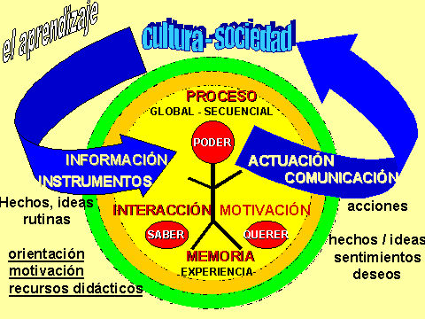

Slide 7
STRATEGY APPLIED IN RESEARCH.
All the work was developed in constant interaction between students and teachers. Each student developed a unique work. Cognitive tasks and application of part plans with their standards, assembly plans and professional software were applied at work. Independent work played a predominant role, ensuring that each student grew technically and professionally, fulfilling their know-how, knowing how to be, and demonstrating their own convictions in solving the work.

Slide 8
RESULTS.
Of a total of 26 students. 26 were approved. With 5………19 students. With 4……… 5 students. With 3……… 2 students Therefore, the quality of the research work on learning met the objectives of each class and each activity that was developed.

Slide 9
The survey demonstrated the weak preparation that students have at the beginning of tackling design work, regarding representation standards, dimensioning, adjustments, surface roughness, application of ISO NCs in part drawings, assembly drawings and technical specification. , etc. All this regardless of whether they have received it in the first year of the degree and do not work on it again until the last year, hence the need to work together on applied drawing and design, since a design is not conceived without the application of drawing, Therefore, the proposal must be promoted to obtain quality in the teaching-learning process and thus contribute to the engineering development of teaching in the mechanical engineering career at our Central University ¨Marta Abreu¨ of Las Villas.

Slide 10
CONCLUSIONS.
Didactics is the art of learning everyday life, including it in learning with passion, love, and deep conviction that you are forming new generations of men and women, capable of carrying out any work aimed at research that enhances their cultural development. and technical, transmitting communication and making themselves understood to meet the learning objectives, motivating them to continue delving into new technologies and computing.

Slide 11
Didactics is the art of learning everyday life, including it in learning with passion, love, and deep conviction that you are forming new generations of men and women, capable of carrying out any work aimed at research that enhances their cultural development. and technical, transmitting communication and making themselves understood to meet the learning objectives, motivating them to continue delving into new technologies and computing.

Slide 12
FAMOUS PHRASES.
The mind is like a parachute: it only works if it is opened. Albert Einstein. The great objective of learning is not knowledge, but action. Herbert Spencer. The formation of a Martian culture is part inseparable from the historical culture that everything must possess Cuban educator. José Martí….Thank you very much.

